Slide 1
Magic square

Slide 2
TRAINING PRESENTATION
Gerald Jan Balverde

Slide 3
AGENDA
Basic and Advance SQL

Slide 4
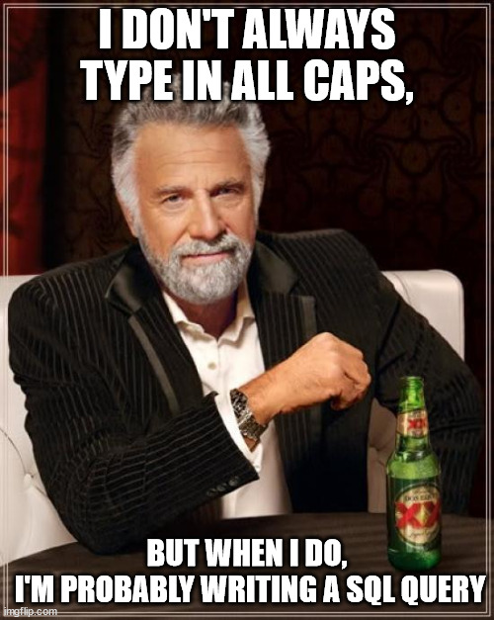
What is SQL?
Structured Query Language is the standard language used for relational database management systems (RDBMS). What is RDBMS? A database management system that manages data as a collection of tables in which all relationships are represented by common values in related tables

Slide 5
Basics
Of SQL

Slide 6

DATA MANIPULATION LANGUAGE(DML)
This manipulation involves inserting data into database
tables, retrieving existing data, deleting data from existing
tables and modifying existing data.

Slide 7
Select
SELECT statement is used to retrieve records from one or more tables in your SQL database. The records retrieved are known as a result set.

Slide 8
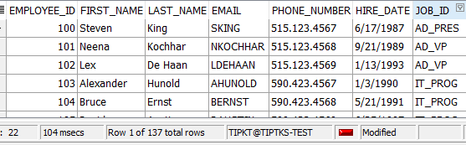
SYNTAX:
SELECT (column) FROM (table)
SELECT DISTINCT | COLUMN NAME | COLUMN ALIAS | ARITHMETIC EXPRESSIONS | || {CONCAT} | LITERALS
FROM
Ex.
SELECT employee_id,
First_name,
Last_name,
Email,
Phone_number
Hire_date
Job_id
FROM employees;

Slide 9
INSERT
INSERT statement is used to insert a one or more records into a table.

Slide 10
INSERT INTO table (column1, column2, ... ) VALUES (expression1, expression2, ... );
SYNTAX:
INSERT INTO table (column1, column2, ... )
VALUES (expression1, expression2, ... );
Ex.
insert into MyCustomers(customer_id,
customer_username,
customer_password )
values
(
1,
'sdvas',
'sdvds'
);
<- These parameters is optional if you want to encode a specific row value, otherwise encode all values

Slide 11
UPDATE
UPDATE statement is used to update existing records in the tables.

Slide 12
SYNTAX:
UPDATE table
SET column1 = expression1, column2 = expression2
[WHERE conditions];
Ex.
UPDATE MyCustomers
SET status = 'logged out'
WHERE customer_username = 'gerbal’;
<- Remove the WHERE clause if you want to update all values of columns in SET clause

Slide 13
DELETE
DELETE statement is a used to delete one or more records from a table.

Slide 14
DELETE FROM table [WHERE conditions];
DELETE FROM suppliers WHERE supplier_name = 'Microsoft';
SYNTAX:
DELETE FROM table [WHERE conditions];
Ex.
DELETE FROM MyCustomers
WHERE customer_username = 'gerbal’;
<- Removing this WHERE clause will delete all rows

Slide 15
Data definition language (DDL)
definition language (DDL) is a computer language used to create and modify the structure of database objects in a database. These database objects include views, schemas, tables, indexes, etc.

Slide 16
Create
CREATE TABLE statement allows you to create and define a table.

Slide 17
DELETE FROM table [WHERE conditions];
CREATE TABLE table_name ( column1 datatype [ NULL | NOT NULL ], column2 datatype [ NULL | NOT NULL ], ... column_n datatype [ NULL | NOT NULL ] );
SYNTAX:
CREATE TABLE table_name ( column1 datatype Constraint
column2 datatype Constraint
Ex.
CREATE TABLE MyCustomers
(
customer_id number(10) PRIMARY KEY ,
customer_username varchar2(50) UNIQUE NOT NULL,
customer_password varchar2(50) NOT NULL,
date_created date default sysdate NOT NULL
);
<- Blue is Constraint
^ Red is data type

Slide 18
ALTER
ALTER TABLE table_name ADD column_name column_definition;
ADD A COLUMN

Slide 19
ALTER TABLE table_name MODIFY (column_1 column_type, column_2 column_type, ... column_n column_type);
ADD A COLUMN
ALTER TABLE MyCustomers
ADD status varchar2(10) DEFAULT 'logged out'
ADD A MULTIPLE COLUMN
ALTER TABLE table_name
ADD (column_1 datatype Constraint ,
column_2 datatype Constraint ,
column_3 datatype Constraint );
MODIFY A COLUMN
ALTER TABLE MyCustomers
MODIFY customer_id number(10)
MODIFY A MULTIPLE COLUMN
ALTER TABLE table_name
MODIFY (column_1 column_definition,
column_2 column_definition,
column_n column_definition);

Slide 20
ALTER TABLE table_name MODIFY (column_1 column_type, column_2 column_type, ... column_n column_type);
DROP A COLUMN
ALTER TABLE MyCustomers
DROP COLUMN customer_id (ne need for data type)
RENAME A COLUMN
ALTER TABLE MyCustomers
RENAME COLUMN customer_id to ID
RENAME A TABLE
ALTER TABLE MyCustomers
RENAME TO CustomersNiGerb

Slide 21
DROP
ALTER TABLE table_name ADD column_name column_definition;
DROP TABLE statement allows you to remove or delete a table from the Oracle database.
SYNTAX:
DROP TABLE [schema_name].table_name
^ schema name is optional
drop table MyCustomers

Slide 22
COMMENT
ALTER TABLE table_name ADD column_name column_definition;
These comments can appear on a single line or span across multiple lines.
Symbol:
-- (double dash)
--select * from mycustomers
/* */
/*
CREATE TABLE MyCustomers
(
customer_id number(10) PRIMARY KEY ,
customer_username varchar2(500) UNIQUE NOT NULL,
customer_password varchar2(500) NOT NULL,
date_created date default sysdate NOT NULL,
no_of_transactions number default 0 not null
);
*/

Slide 23
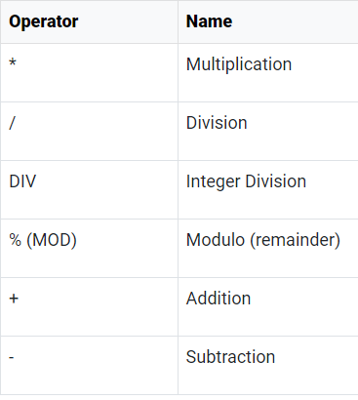


Arithmetic Operators
Arithmetic operators can be used in the SELECT, WHERE clauses. IT FOLLOWS PEMDAS
Ex.
In SELECT clause
SELECT salary + (salary * 0.5) AS salary_increase_30
FROM employees;
In WHERE clause
select first_name, last_name
from employees
where mod(salary, 2) = 1
--salary is odd number
^ (Power) | Raises one number by another number.

Slide 24
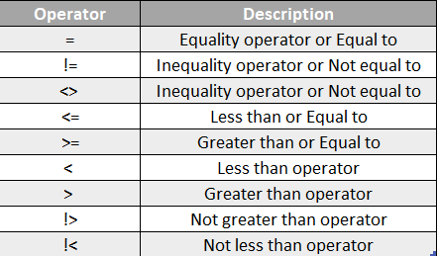
Comparison Operators
Comparison operators are used in the WHERE clause to determine which records to select.
Ex.
SELECT salary + (salary * 0.5) AS salary_increase_30
FROM employees;
In SELECT clause
SELECT first_name, last_name
FROM employees
WHERE MOD(salary, 2) = 1
--WHERE salary is odd number

Slide 25
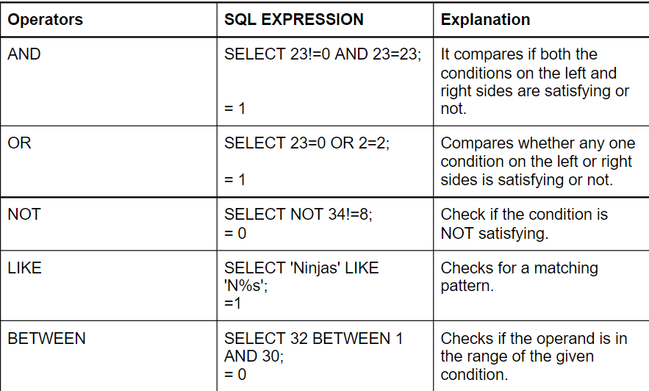
LogiCAL Operators
SELECT * FROM employees
WHERE customer_id = '10’ AND department_id = 80
SELECT *
FROM employees
WHERE job_id = 'IT_PROG' OR job_id = 'HR_REP'
SELECT last_name, salary
FROM employees
WHERE last_name LIKE '_e%'
SELECT employee_id, first_name, salary as sweldo
FROM employees
WHERE not employee_id between 100 AND 150

Slide 26
Example

Slide 27








MEET OUR Extended TEAM
TAKUMA HAYASHI
MIRJAM NILSSON
FLORA BERGGREN​
RAJESH SANTOSHI​
President
Chief Executive Officer
Chief Operations Officer
VP Marketing
GRAHAM BARNES
ROWAN MURPHY
ELIZABETH MOORE
ROBIN KLINE
VP Product
SEO Strategist
Product Designer
Content Developer

Slide 28





PLAN FOR PRODUCT LAUNCH
PLANNING
MARKETING
DESIGN
STRATEGY
LAUNCH
Synergize scalable e-commerce
Disseminate standardized metrics
Coordinate e- business applications
Foster holistically superior methodologies
Deploy strategic networks with compelling e- business needs

Slide 29
TIMELINE
SEP 20XX
NOV 20XX
JAN 20XX
MAR 20XX
MAY 20XX
Synergize scalable e-commerce
Disseminate standardized metrics
Coordinate e- business applications
Foster holistically superior methodologies
Deploy strategic networks with compelling e- business needs

Slide 30
AREAS OF FOCUS
B2B MARKET SCENARIOS
CLOUD-BASED OPPORTUNITIES
Develop winning strategies to keep ahead of the competition
Capitalize on low-hanging fruit to identify a ballpark value
Visualize customer directed convergence
Iterative approaches to corporate strategy
Establish a management framework from the inside

Slide 31



HOW WE GET THERE
ROI
NICHE MARKETS
SUPPLY CHAINS
Envision multimedia-based expertise and cross-media growth strategies
Visualize quality intellectual capital
Engage worldwide methodologies with web-enabled technologies
Pursue scalable customer service through sustainable strategies
Engage top-line web services with cutting-edge deliverables
Cultivate one-to-one customer service with robust ideas
Maximize timely deliverables for real-time schemas

Slide 32
SUMMARY
At Contoso, we believe in giving 110%. By using our next-generation data architecture, we help organizations virtually manage agile workflows. We thrive because of our market knowledge and great team behind our product. As our CEO says, "Efficiencies will come from proactively transforming how we do business."

Slide 33
THANK YOU
Mirjam Nilsson​
mirjam@contoso.com
www.contoso.com

